Slide 1
Naive Bayes
Algorithm
Chaithanya pavankumar Chenna

Slide 2
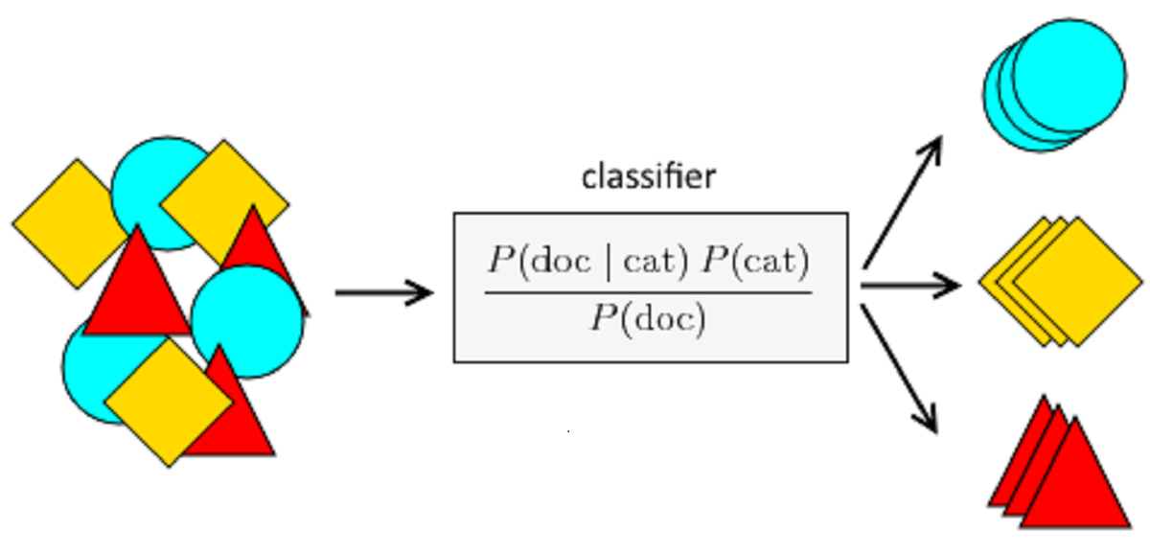
Index
Introduction
Bayes' Theorem
Types of Naive Bayes
How Naive Bayes Works
Advantages and Disadvantages of Naive Bayes
Implementation of Naive Bayes
Conclusion

Slide 3
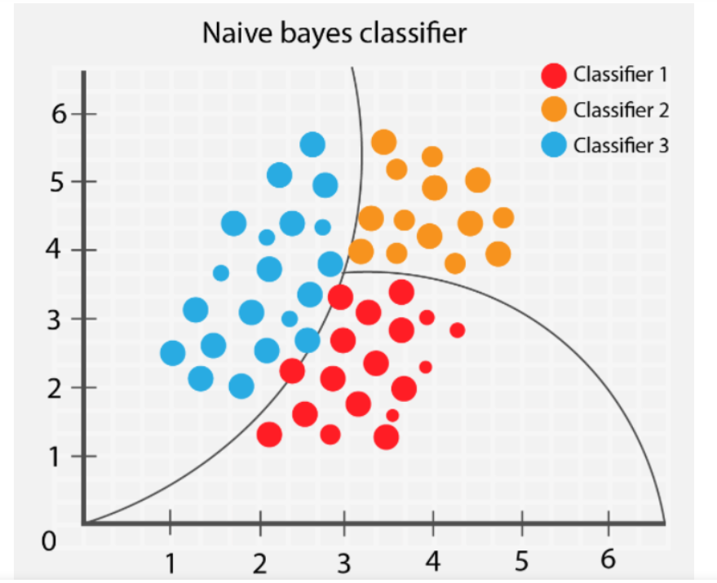
Introduction
What is Naive Bayes ?
Naive Bayes: Naive Bayes is a classification algorithm that is used to make predictions based on probability theory.
Importance: Naive Bayes is widely used in natural language processing, text classification, spam filtering, sentiment analysis, and many other applications.
Applications: Naive Bayes can be used for various tasks like sentiment analysis, spam detection, text classification, recommendation systems, and more.

Slide 4
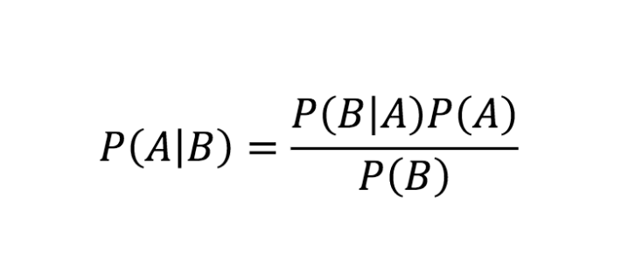
Bayes' Theorem
Bayes' Theorem: Bayes' theorem is a formula that calculates the probability of an event occurring, based on prior knowledge of conditions that might be related to the event.
Use in Naive Bayes: Naive Bayes uses Bayes' theorem to calculate the probability of each class given the features of the input data.

Slide 5
Types of Naive Bayes
There are three types of Naive Bayes: Gaussian, Multinomial, and Bernoulli.
Gaussian Naive Bayes : Naive Bayes can be extended to real-valued attributes, most commonly by assuming a Gaussian distribution. This extension of naive Bayes is called Gaussian Naive Bayes.
Multinomial Naive Bayes : It is a type of Naive Bayes algorithm that is used for classification tasks on discrete data. It is commonly used for text classification tasks, such as email spam filtering, sentiment analysis, and topic classification.
Bernoulli Naive Bayes : It is another type of Naive Bayes algorithm that is used for classification tasks on binary or boolean data. It is commonly used for text classification tasks, where the input data is represented as a binary vector,indicating whether each term in the document vocabulary occurs in the document or not.

Slide 6
How Naive Bayes Works
Predictions: Naive Bayes makes predictions by calculating the probability of each class given the input features and selecting the class with the highest probability.
Naive assumption: The "naive" assumption in Naive Bayes is that all features are independent and contribute equally to the class probability.
Probability: Probability plays a critical role in Naive Bayes, as it is used to calculate the likelihood of the data given the class and the prior probability of the class.

Slide 7
Advantages and Disadvantages of Naive Bayes
Advantages:
Naive Bayes is easy to implement.
It is fast, and can work well with a small amount of data.
It also performs well on high-dimensional data and is resistant to overfitting.
Disadvantages:
Naive Bayes assumes that all features are independent and that the data is randomly sampled.
It may not perform well when these assumptions are violated, and it can suffer from the problem of zero frequency.

Slide 8
Implementation of Naive Bayes
Implementation: To implement Naive Bayes, need to first train a model on labeled data, where both the features and the correct class label. Then use the model to make predictions on new, unlabeled data.
Step 1: Convert the data set into a frequency table
Step 2: Create Likelihood table by finding the probabilities like Overcast probability = 0.29 and probability of playing is 0.64.
Step 3: Now, use Naive Bayesian equation to calculate the posterior probability for each class. The class with the highest posterior probability is the outcome of the prediction.

Slide 9
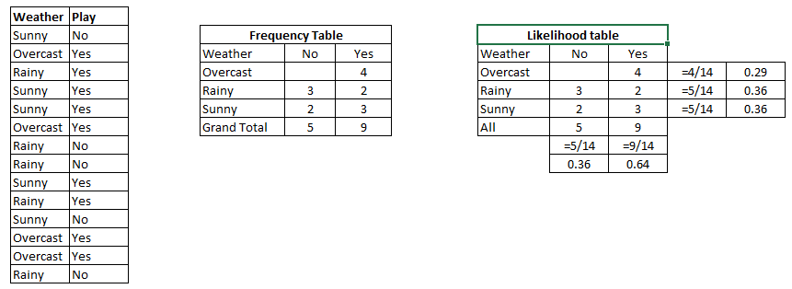

Slide 10
Problem: Players will play if the weather is sunny. Is this statement correct?
We can solve it using the above-discussed method of posterior probability.
P(Yes | Sunny) = P( Sunny | Yes) * P(Yes) / P (Sunny)
Here P( Sunny | Yes) * P(Yes) is in the numerator, and P (Sunny) is in the denominator.
Here we have P (Sunny |Yes) = 3/9 = 0.33, P(Sunny) = 5/14 = 0.36, P( Yes)= 9/14 = 0.64
Now, P (Yes | Sunny) = 0.33 * 0.64 / 0.36 = 0.60, which has higher probability.
The Naive Bayes uses a similar method to predict the probability of different class based on various attributes. This algorithm is mostly used in text classification (nlp) and with problems having multiple classes.

Slide 11
Conclusion
Naive Bayes has some limitations. It assumes that the features are independent, which may not be true for some real-world problems. It also requires a large amount of data to accurately estimate the probabilities.

Slide 12
References
https://machinelearningmastery.com/naive-bayes-for-machine-learning/
https://www.analyticsvidhya.com/blog/2017/09/naive-bayes-explained/
http://stats.stackexchange.com/ 151 33.3. Contact the Author 152  Stack Overflow:
http://stackoverflow.com/questions/tagged/machine-learning  Data Science:
http://datascience.stackexchange.com/  Reddit Machine Learning:
http://www.reddit.com/r/machinelearning  Quora Machine Learning
https://www.quora.com/topic/Machine-Learning/top_stories

